Slide 1

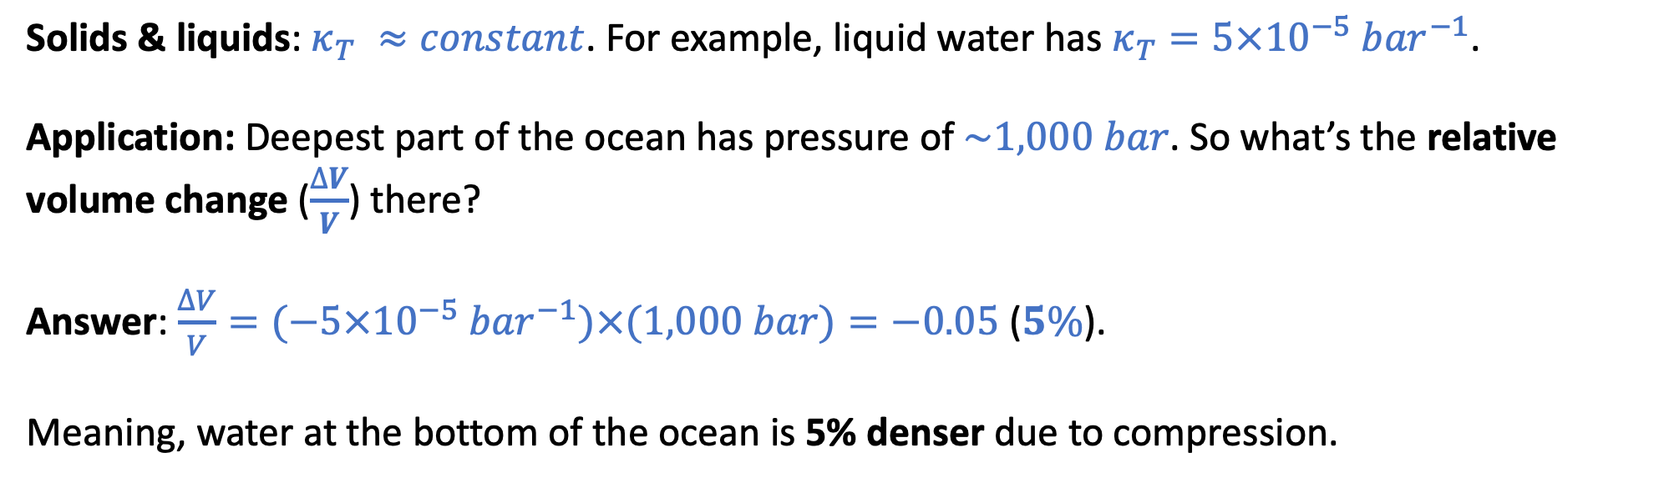
The “Isothermal compressibility” ($κ_{T}$)
$$κ_{T}≡−\frac{1}{V}{\left(\frac{∂V}{∂P}\right)}_{T}$$
for small changes in pressure (or if $κ_{T}$ really is constant) we can say $\frac{∆V}{V}≈{−κ}_{T}∆P$
Solids & liquids: $κ_{T} ≈constant$. For example, liquid water has $κ_{T}=5×10^{−5}{ bar}^{−1}$.
Application: Deepest part of the ocean has pressure of $\sim 1,000 bar$. So what’s the relative volume change ($\frac{∆V}{V}$) there?
Answer: $\frac{∆V}{V}=(−5×10^{−5}{ bar}^{−1})×(1,000 bar)=−0.05$ ($5\%$).
Meaning, water at the bottom of the ocean is 5% denser due to compression.

Slide 2
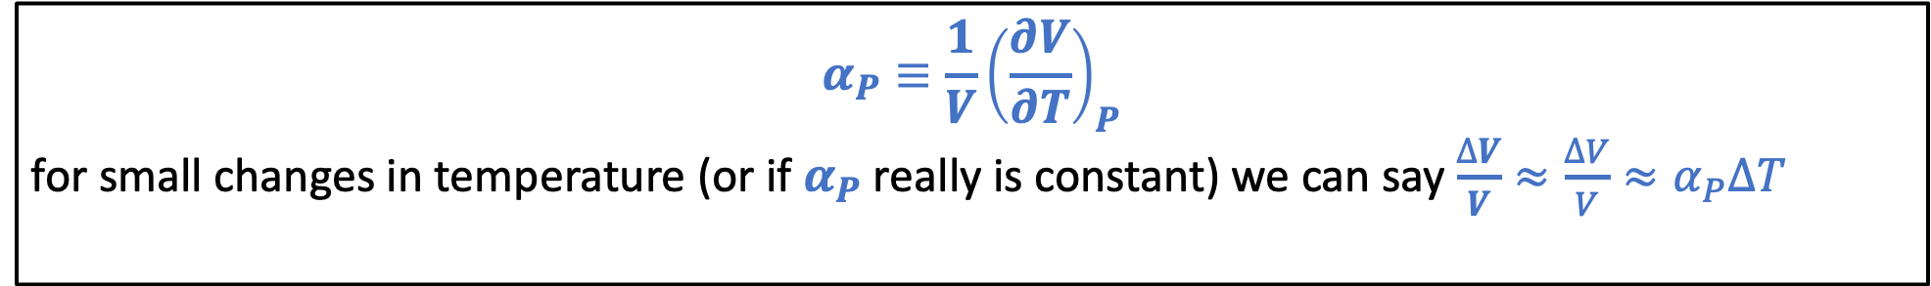


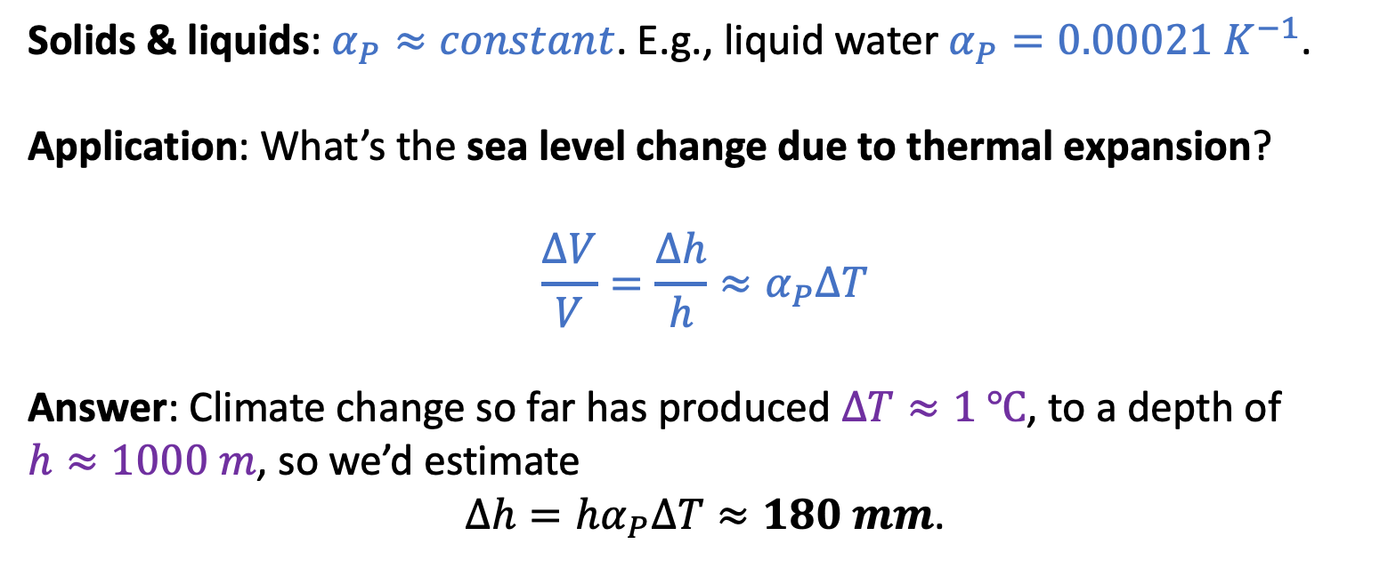
The “Isobaric expansivity” ($α_{P}$)
$$α_{P}≡\frac{1}{V}{\left(\frac{∂V}{∂T}\right)}_{P}$$
for small changes in temperature (or if $α_{P}$ really is constant) we can say $\frac{∆V}{V}≈{\frac{∆V}{V}≈α}_{P}∆T$
$$h$$
$$∆h$$
Solids & liquids: $α_{P}≈constant$. E.g., liquid water $α_{P}=0.00021{ K}^{−1}$.
Application: What’s the sea level change due to thermal expansion?
$${\frac{∆V}{V}=\frac{∆h}{h}≈α}_{P}∆T$$
Answer: Climate change so far has produced $∆T≈1 ℃$, to a depth of
$h≈1000 m$, so we’d estimate
$∆h=hα_{P}∆T≈180 mm$.

Slide 3
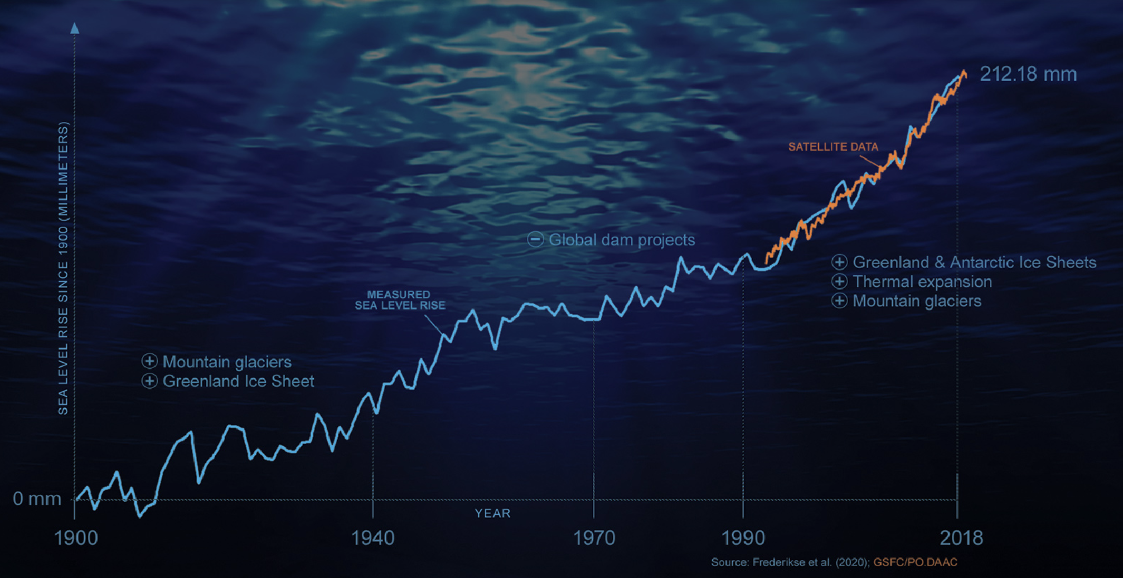
Other causes of sea level rise
https://climate.nasa.gov/news/3012/nasa-led-study-reveals-the-causes-of-sea-level-rise-since-1900/
Thermal expansion of oceans accounts for something like 180 mm rise.
The rest must be due to the loss of land ice (maybe by melting, maybe by chunks of ice sliding into the ocean)

Slide 4
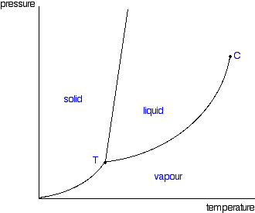
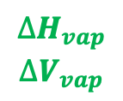
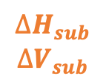
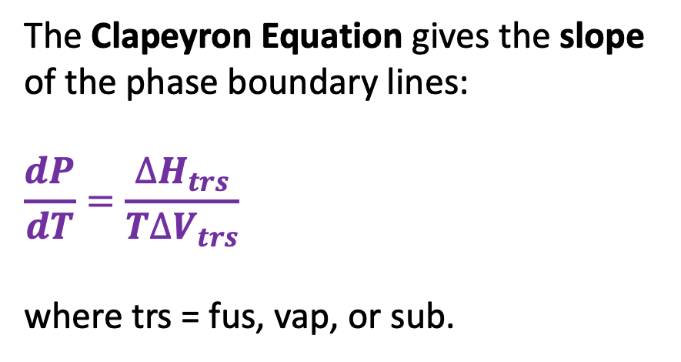
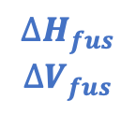
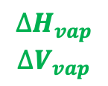
The Clapeyron equation
The Clapeyron Equation gives the slope of the phase boundary lines:
$$\frac{dP}{dT}=\frac{∆H_{trs}}{T∆V_{trs}}$$
where trs = fus, vap, or sub.
$$∆H_{fus}$$
$$∆V_{fus}$$
P
$$∆H_{vap}$$
$$∆V_{vap}$$
$$∆H_{vap}$$
$$∆V_{vap}$$
$$∆H_{sub}$$
$$∆V_{sub}$$
T

Slide 5
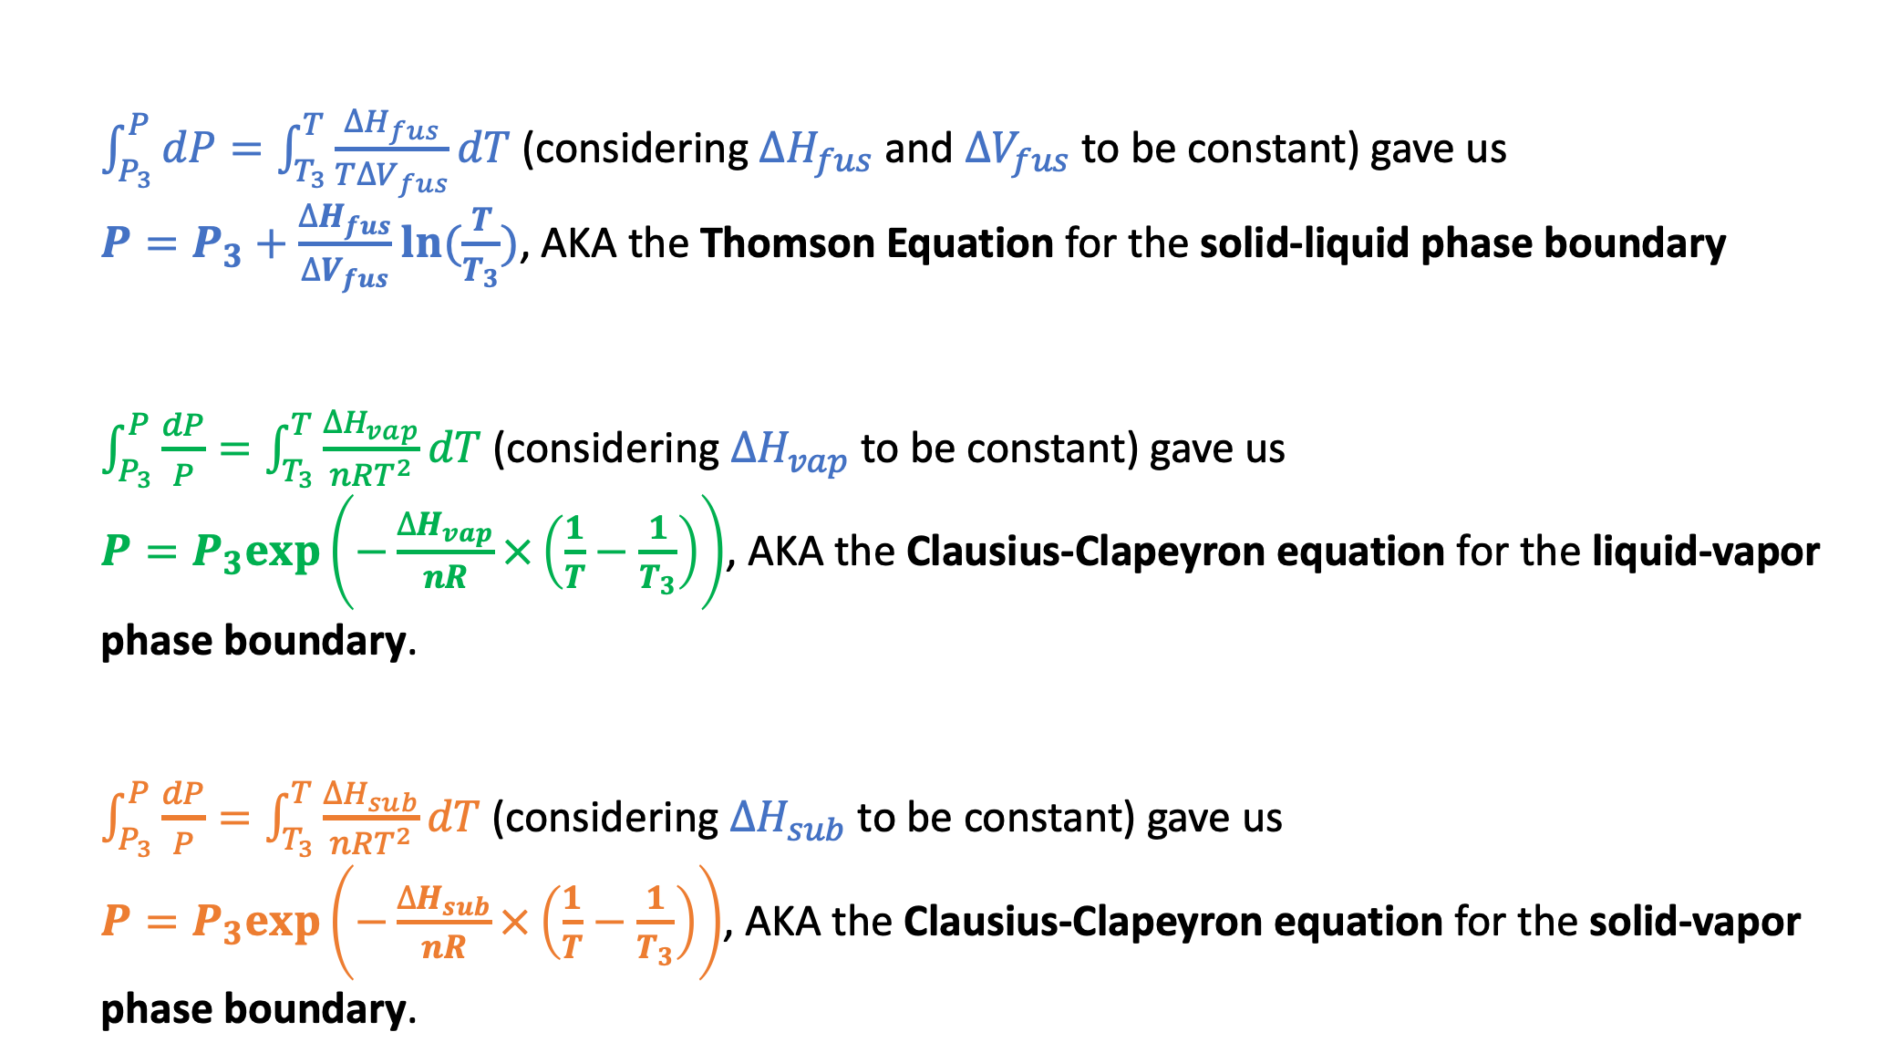
How Clapeyron integrates to Thomson and Clausius-Clapeyron
$\int_{P_{3}}^{P}{dP}=\int_{T_{3}}^{T}{\frac{∆H_{fus}}{T∆V_{fus}}dT}$ (considering $∆H_{fus}$ and $∆V_{fus}$ to be constant) gave us
$P=P_{3}+\frac{∆H_{fus}}{∆V_{fus}}ln⁡(\frac{T}{T_{3}})$, AKA the Thomson Equation for the solid-liquid phase boundary
$\int_{P_{3}}^{P}{\frac{dP}{P}}=\int_{T_{3}}^{T}{\frac{∆H_{vap}}{nRT^{2}}dT}$ (considering $∆H_{vap}$ to be constant) gave us
$P=P_{3}exp⁡\left(−\frac{∆H_{vap}}{nR}×\left(\frac{1}{T}−\frac{1}{T_{3}}\right)\right)$, AKA the Clausius-Clapeyron equation for the liquid-vapor phase boundary.
$\int_{P_{3}}^{P}{\frac{dP}{P}}=\int_{T_{3}}^{T}{\frac{∆H_{sub}}{nRT^{2}}dT}$ (considering $∆H_{sub}$ to be constant) gave us
$P=P_{3}exp⁡\left(−\frac{∆H_{sub}}{nR}×\left(\frac{1}{T}−\frac{1}{T_{3}}\right)\right)$, AKA the Clausius-Clapeyron equation for the solid-vapor phase boundary.

Slide 6
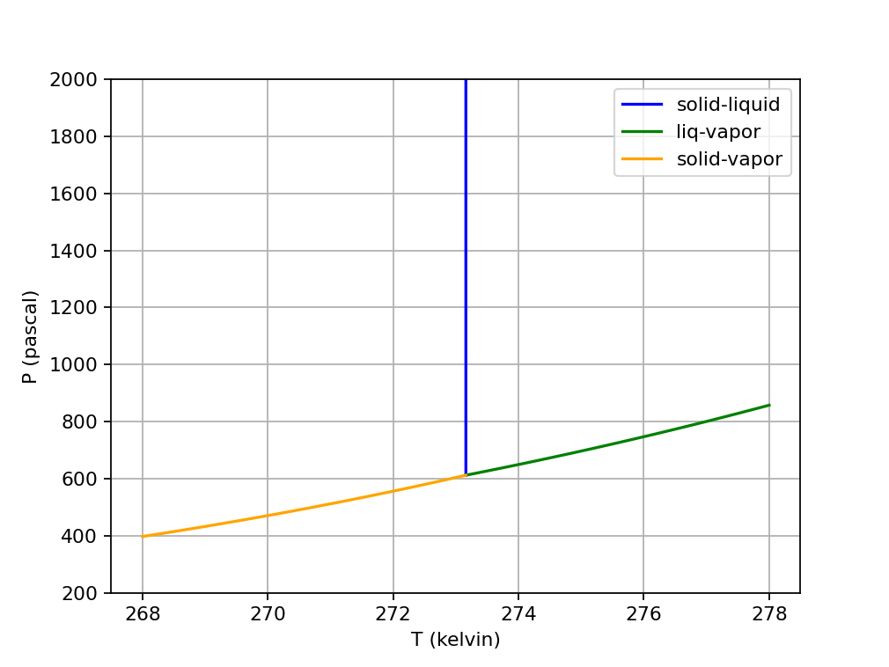
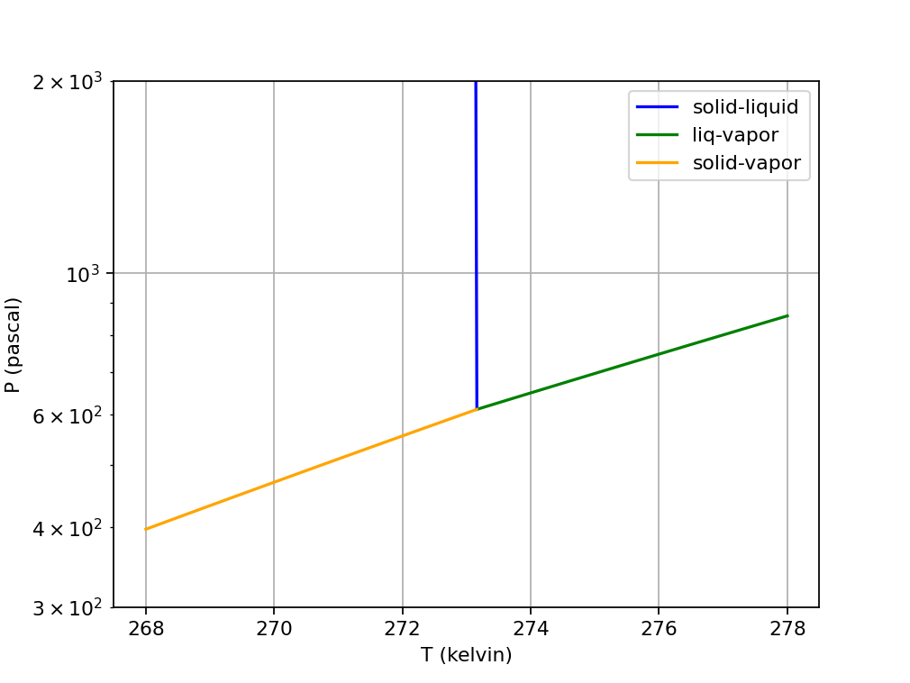
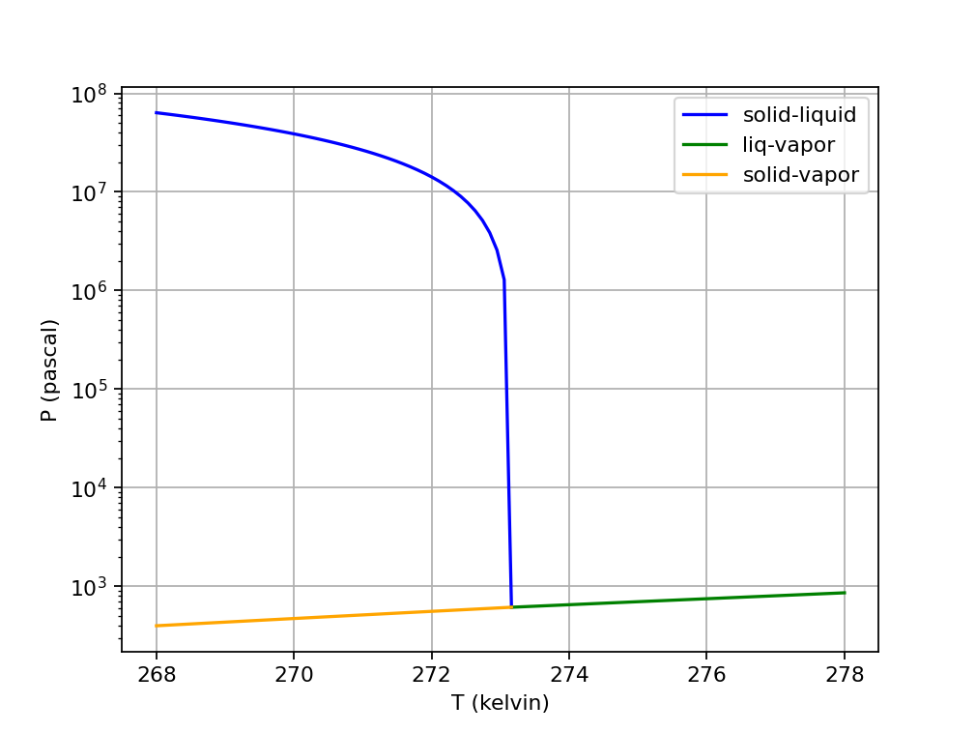
How phase diagrams look different depending on how you scale them
Linear in x & y
y-axis limited to 300-2000
Semilogy
y-axis limited to 300-2000
Semilogy
No limits on y-axis

Slide 7

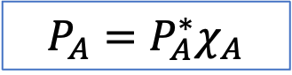


Raoult’s Law
P
A(g)
${P_{A}=P}_{A}^{∗}χ_{A}$
New equilibrium
A
$$P_{A}^{∗}$$
B
A
A
A
A
Solvent A with solute B
B
$$P_{A}$$
A
A
T
Here, $χ_{A}$ is the mole fraction of solvent A in the solution,
$χ_{A}≡\frac{n_{A}}{n_{A}+n_{B}}$. A handy formula: $χ_{A}=\frac{1}{1+M_{A}b_{B}}$ where $b_{B}≡\frac{mol B}{kg A}$ is the solute’s molality.

Slide 8
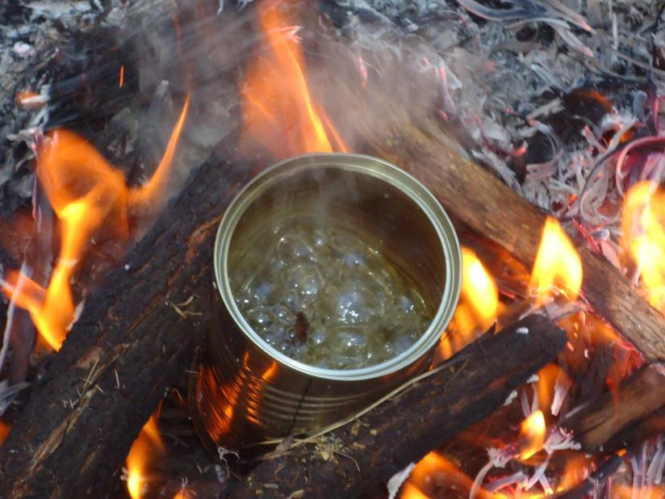
Boiling on Mt. Rainier
P
Atmospheric pressure
On Mt. Rainier
Boiling happens at a lower temperature on Mt. Rainier because atmospheric pressure is lower there.
T

Slide 9
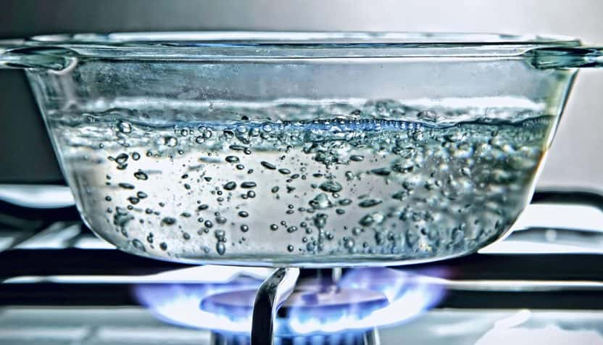


How Raoult explains boiling point elevation
P
$$P_{H_{2}O}^{∗}$$
Standard atmospheric pressure
NaCl
$$P_{H_{2}O}^{∗}χ_{H_{2}O}$$
T
If you add salt to boiling water, it’ll stop boiling (for a moment, anyway) because ${P_{H_{2}O}^{∗}χ_{H_{2}O}<P}_{H_{2}O}^{∗}$.
With the burner on, the temperature will go up until $P_{H_{2}O}^{∗}χ_{H_{2}O}$ reaches atmospheric pressure again.

Slide 10
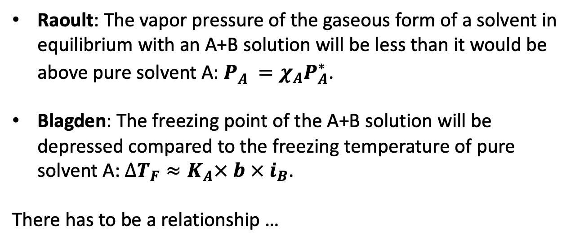
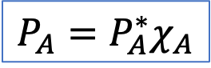
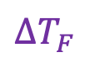
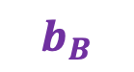
Raoult vs Blagden
A(g)
${P_{A}=P}_{A}^{∗}χ_{A}$
Raoult
Raoult: The vapor pressure of the gaseous form of a solvent in equilibrium with an A+B solution will be less than it would be above pure solvent A: $P_{A}^{}=χ_{A}P_{A}^{∗}$.
Blagden: The freezing point of the A+B solution will be depressed compared to the freezing temperature of pure solvent A: $∆T_{F}≈K_{A}× b × i_{B}$.
There has to be a relationship …
A
B
A
A
A
Solvent A with solute B
B
A
A
$∆T_{F}$
Blagden
$$b_{B}$$

Slide 11
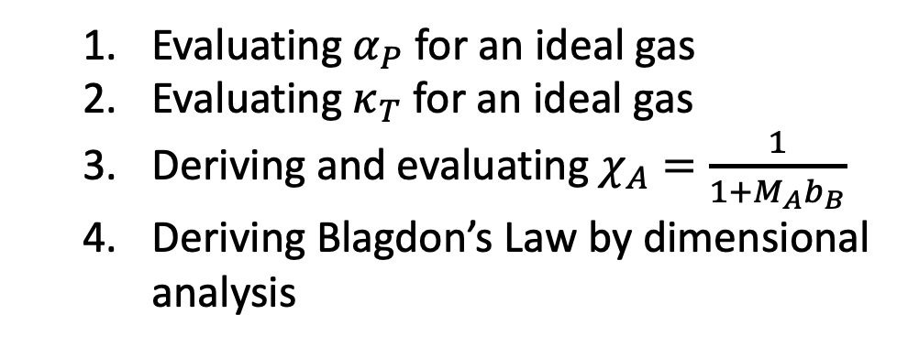
CGIs for today
Evaluating $α_{P}$ for an ideal gas
Evaluating $κ_{T}$ for an ideal gas
Deriving and evaluating $χ_{A}=\frac{1}{1+M_{A}b_{B}}$
Deriving Blagdon’s Law by dimensional analysis

Slide 12
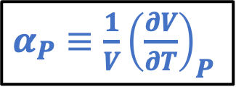
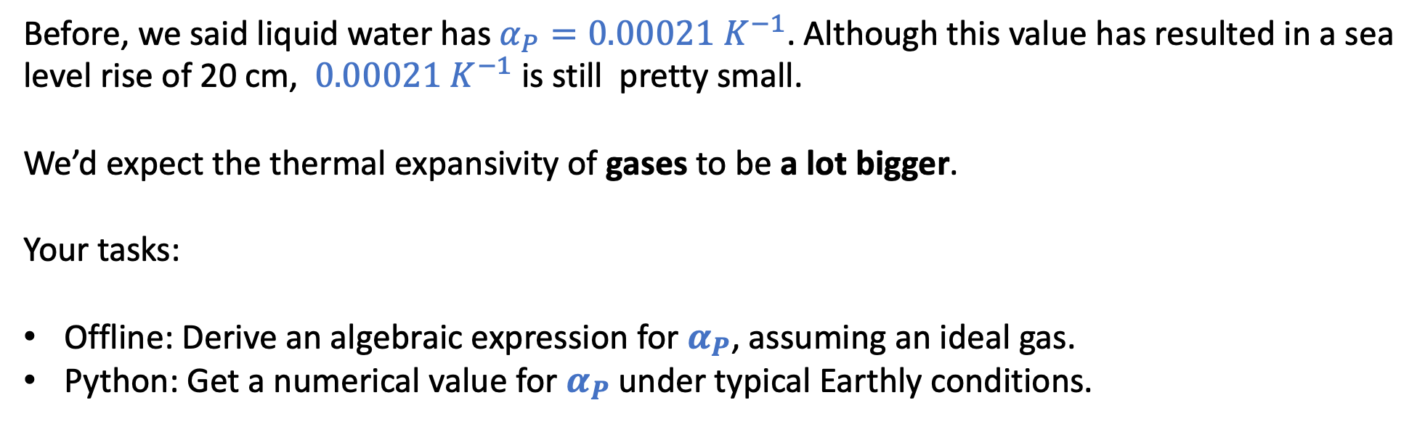
1. Isobaric thermal expansivity of an ideal gas
$α_{P}≡\frac{1}{V}{\left(\frac{∂V}{∂T}\right)}_{P}$
Before, we said liquid water has $α_{P}=0.00021{ K}^{−1}$. Although this value has resulted in a sea level rise of 20 cm, $0.00021{ K}^{−1}$ is still pretty small.
We’d expect the thermal expansivity of gases to be a lot bigger.
Your tasks:
Offline: Derive an algebraic expression for $α_{P}$, assuming an ideal gas.
Python: Get a numerical value for $α_{P}$ under typical Earthly conditions.

Slide 13
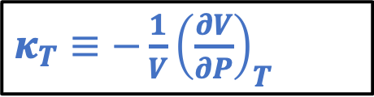
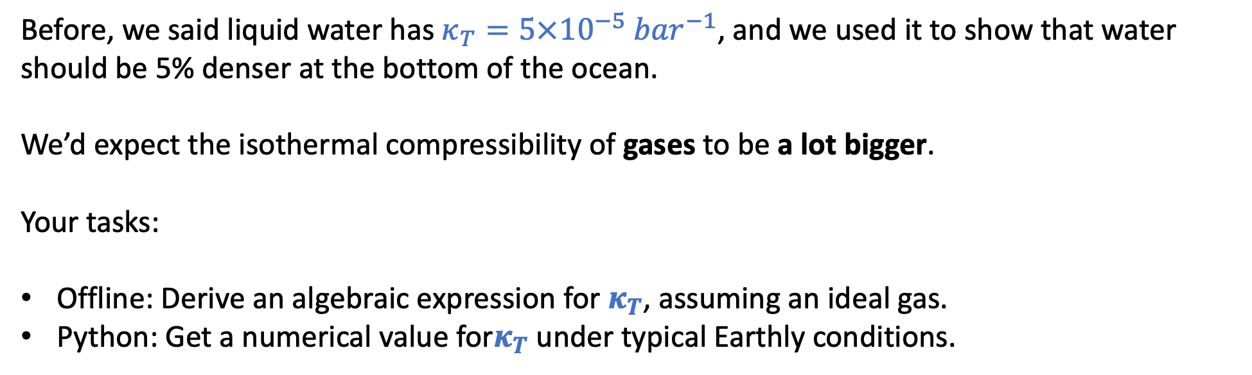
2. Isothermal compressibility of an ideal gas
$κ_{T}≡−\frac{1}{V}{\left(\frac{∂V}{∂P}\right)}_{T}$
Before, we said liquid water has $κ_{T}=5×10^{−5}{ bar}^{−1}$, and we used it to show that water should be 5% denser at the bottom of the ocean.
We’d expect the isothermal compressibility of gases to be a lot bigger.
Your tasks:
Offline: Derive an algebraic expression for $κ_{T}$, assuming an ideal gas.
Python: Get a numerical value for$κ_{T}$ under typical Earthly conditions.

Slide 14
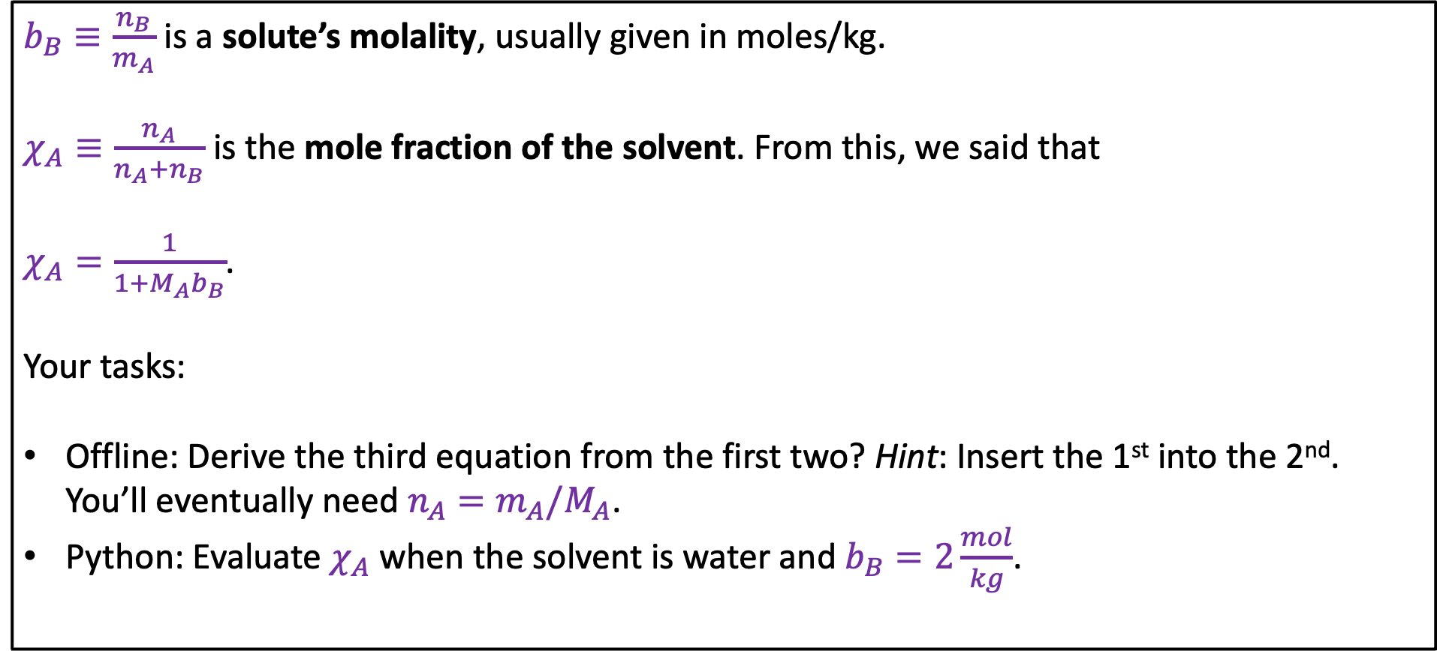
3. Molality and mole fraction
$b_{B}≡\frac{n_{B}}{m_{A}}$ is a solute’s molality, usually given in moles/kg.
$χ_{A}≡\frac{n_{A}}{n_{A}+n_{B}}$ is the mole fraction of the solvent. From this, we said that
$χ_{A}=\frac{1}{1+M_{A}b_{B}}$.
Your tasks:
Offline: Derive the third equation from the first two? Hint: Insert the 1st into the 2nd. You’ll eventually need $n_{A}=m_{A}/M_{A}$.
Python: Evaluate $χ_{A}$ when the solvent is water and $b_{B}=2\frac{mol}{kg}$.

Slide 15

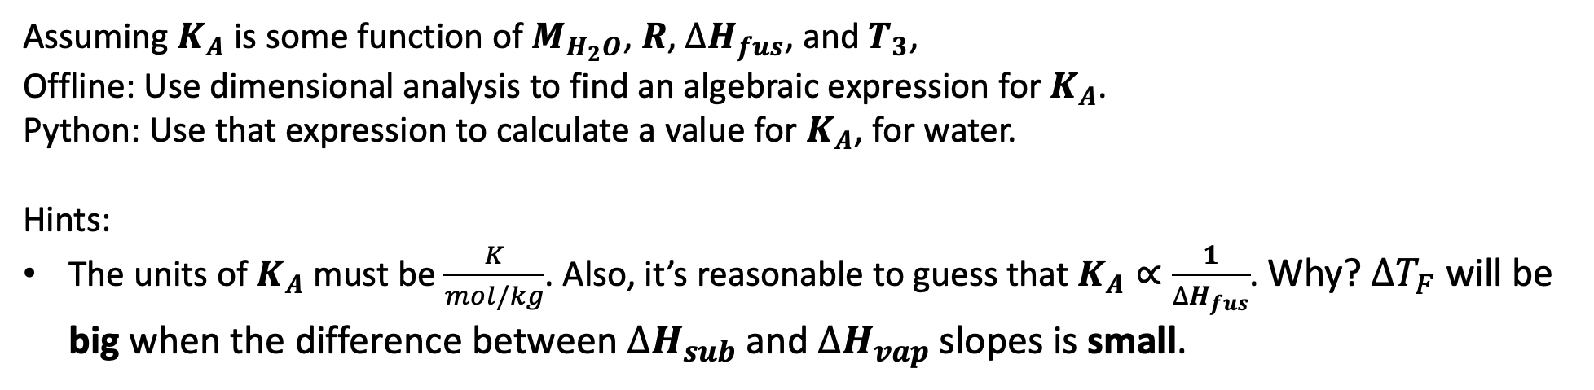

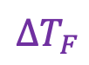
4. Deriving the Cryoscopic Constant $K_{A}$ using dimensional analysis
P
Blagden says $∆T_{F}=K_{A}b_{B} i_{B}$
$∆T_{F}$
T
$$b_{B}$$
Assuming $K_{A}$ is some function of $M_{H_{2}O}$, $R$, $∆H_{fus}$, and $T_{3}$,
Offline: Use dimensional analysis to find an algebraic expression for $K_{A}$.
Python: Use that expression to calculate a value for $K_{A}$, for water.
Hints:
The units of $K_{A}$must be $\frac{K}{mol/kg}$. Also, it’s reasonable to guess that $K_{A}∝\frac{1}{∆H_{fus}}$. Why? $∆T_{F}$ will be big when the difference between $∆H_{sub}$ and $∆H_{vap}$ slopes is small.

